Slide 3
Godzilla Eats
Las Vegas!

Slide 4
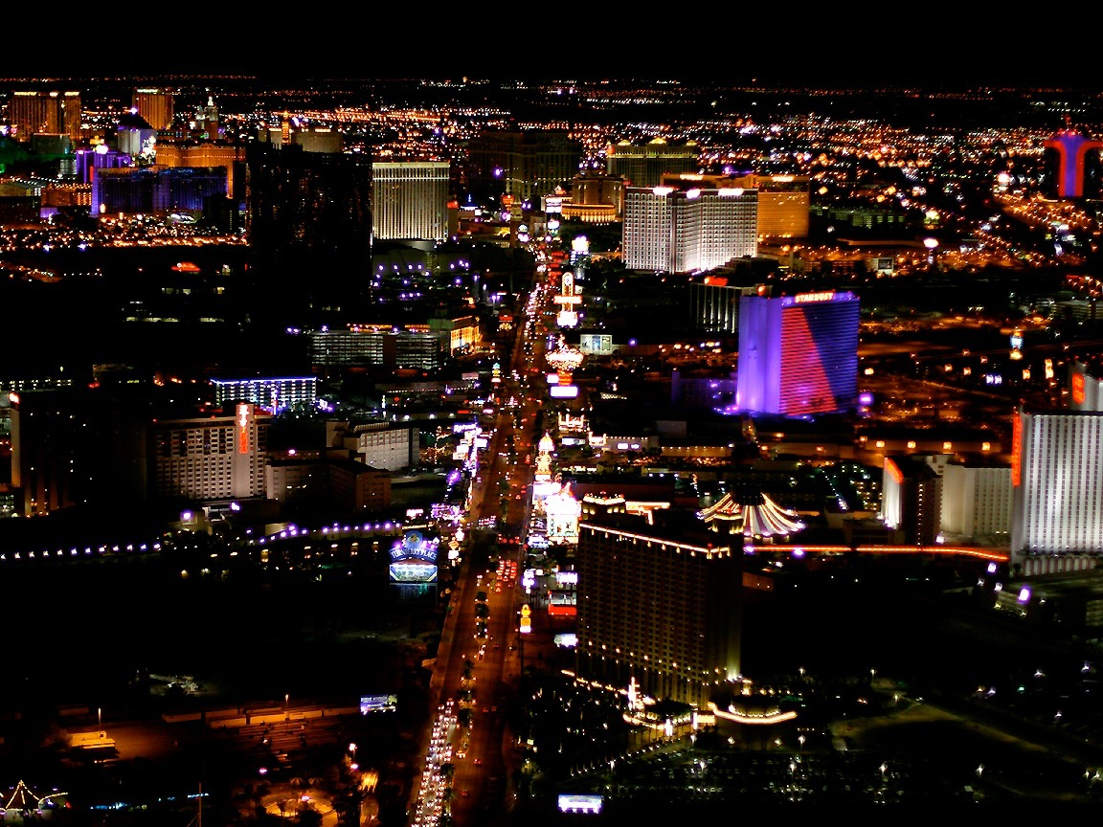
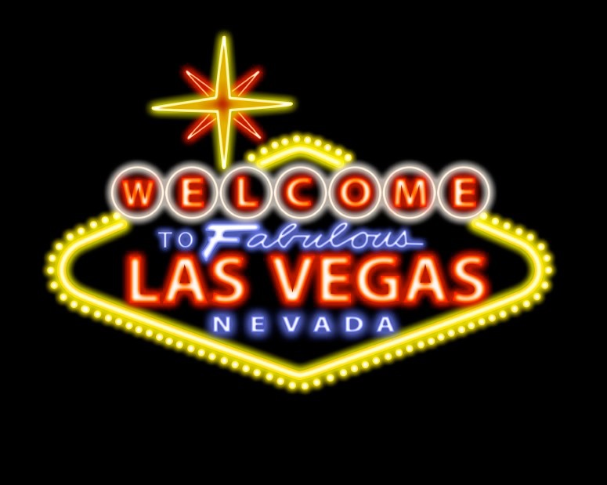
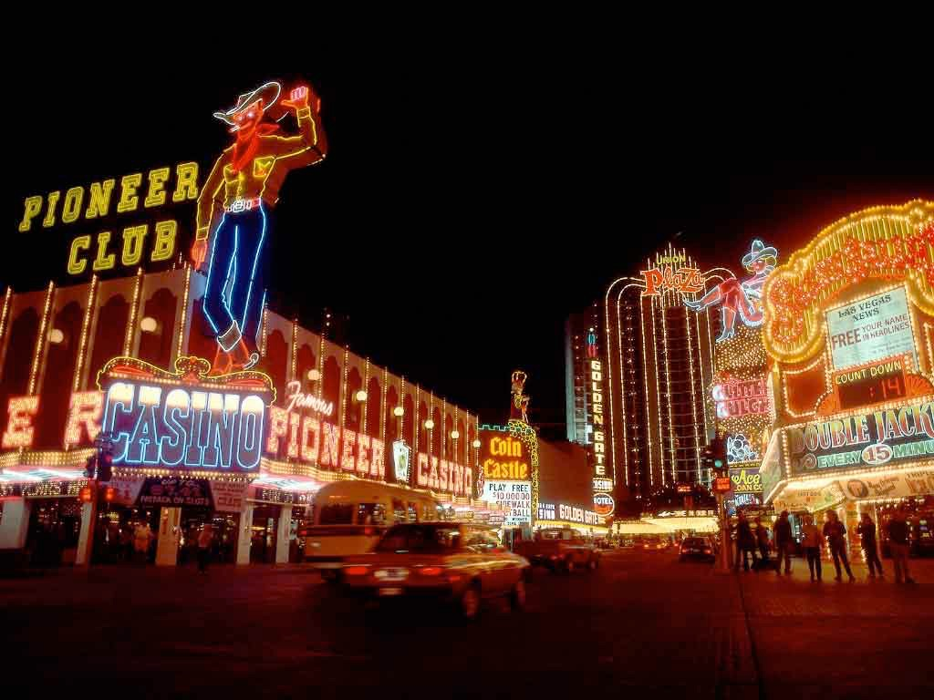
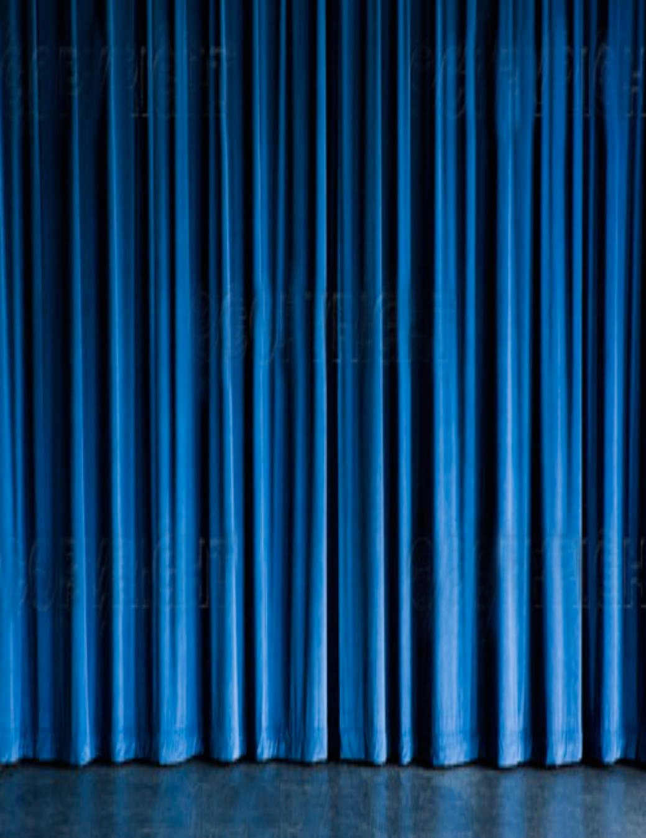
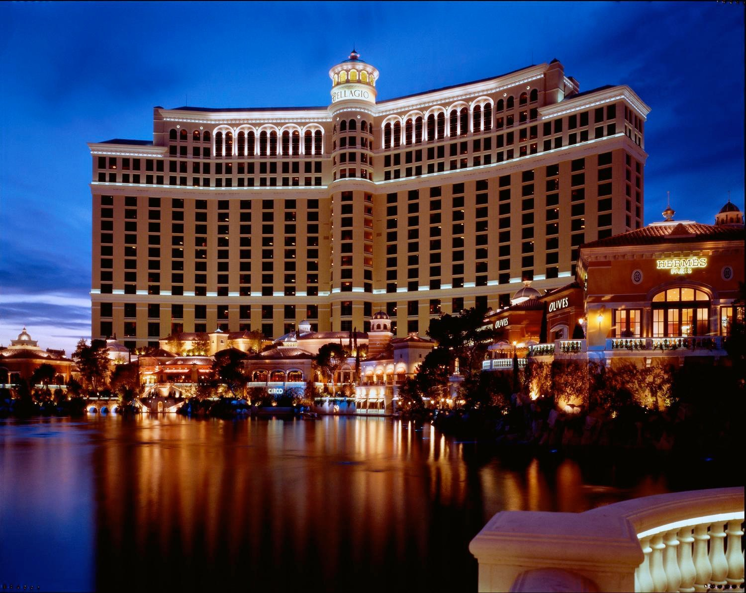
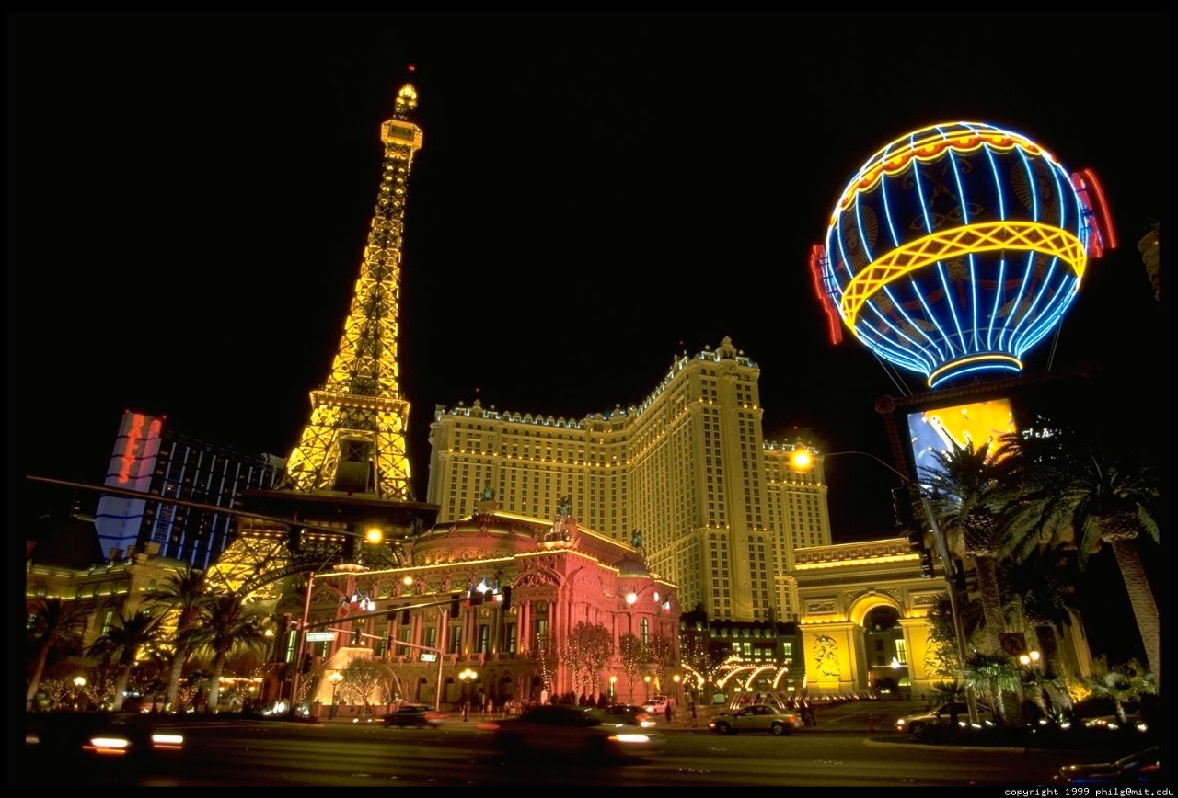

Slide 5
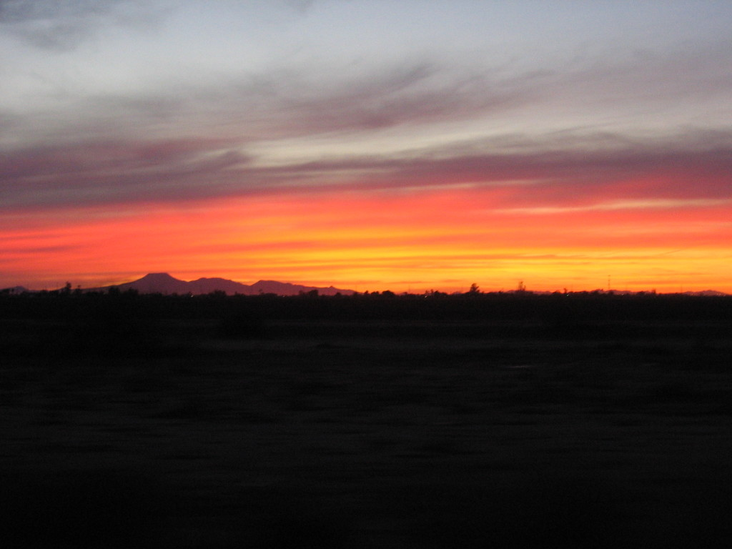
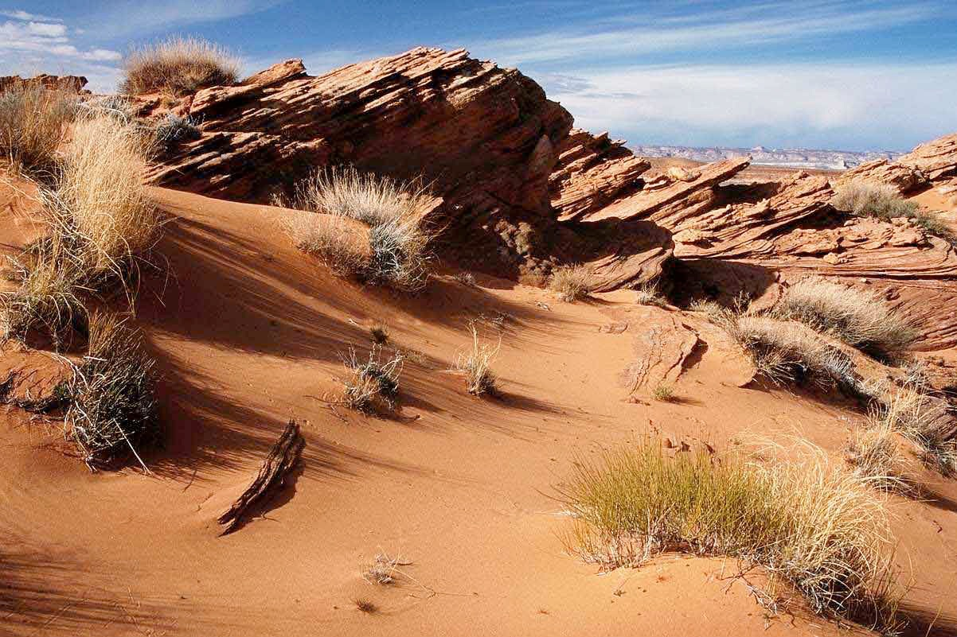
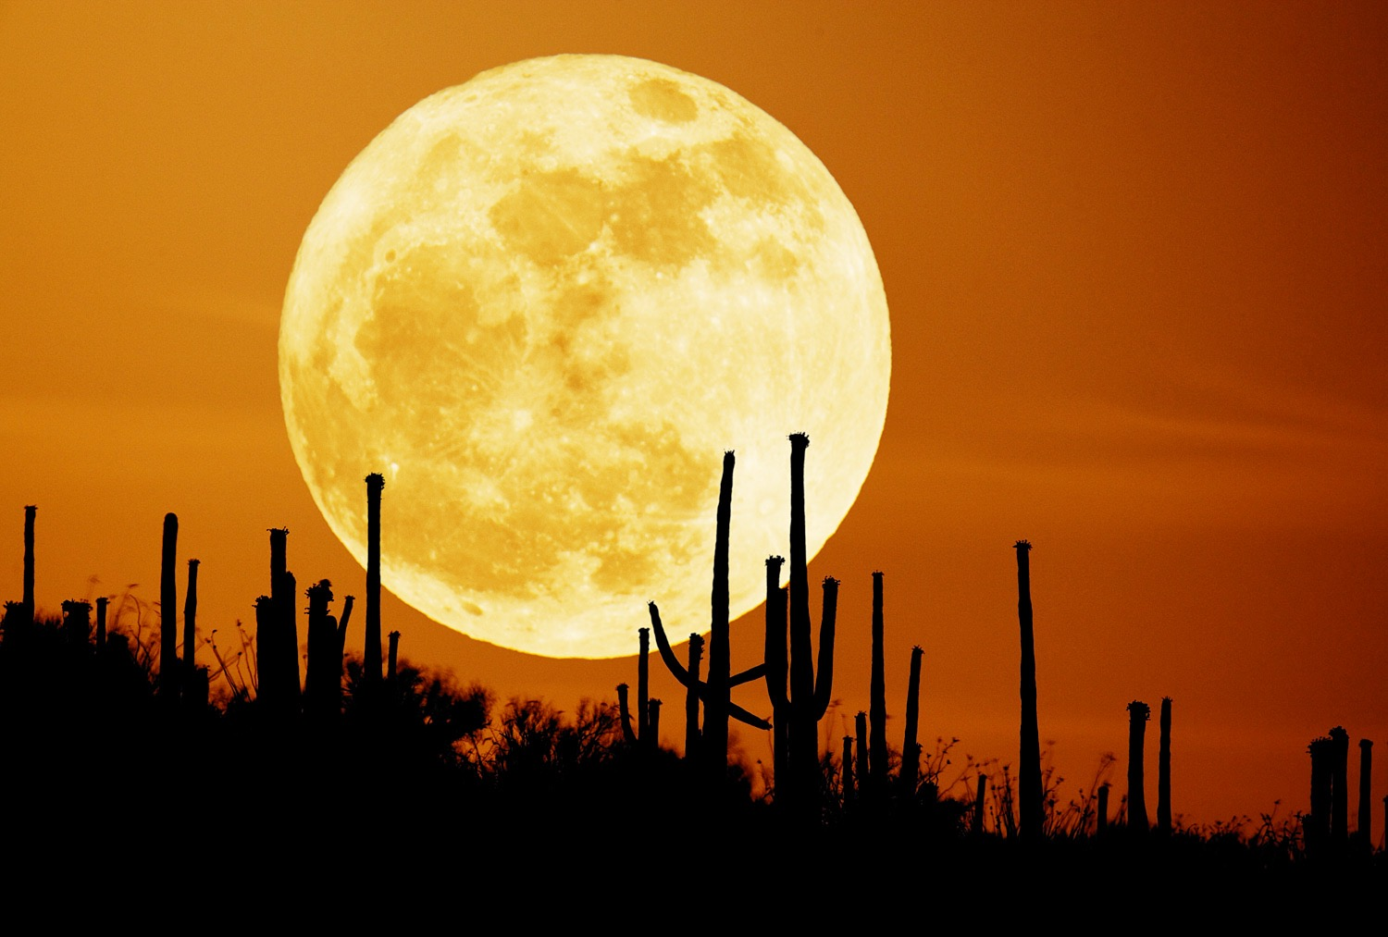
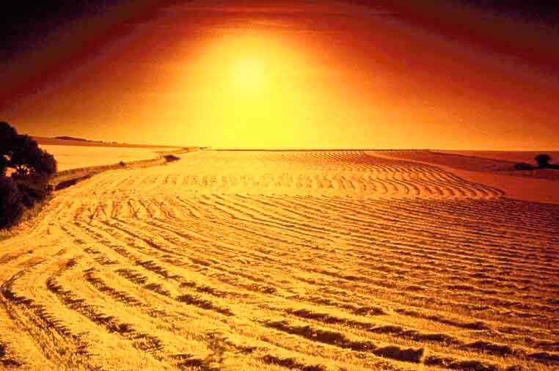
A lone shakuhachi flute ushers the arrival of something really VERY bad.

Slide 6
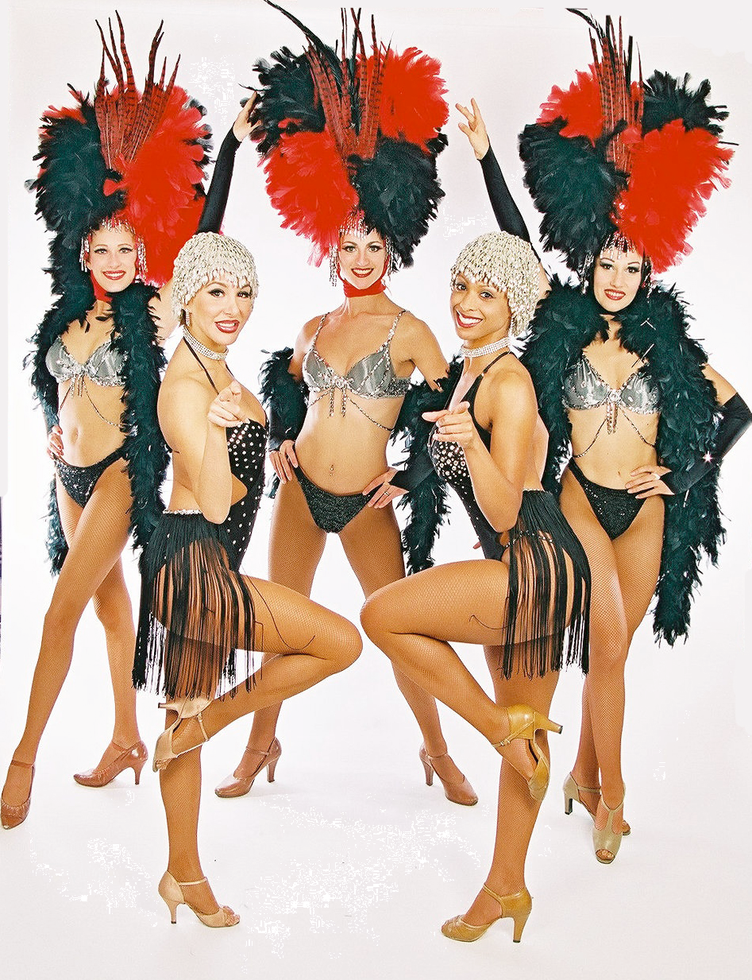
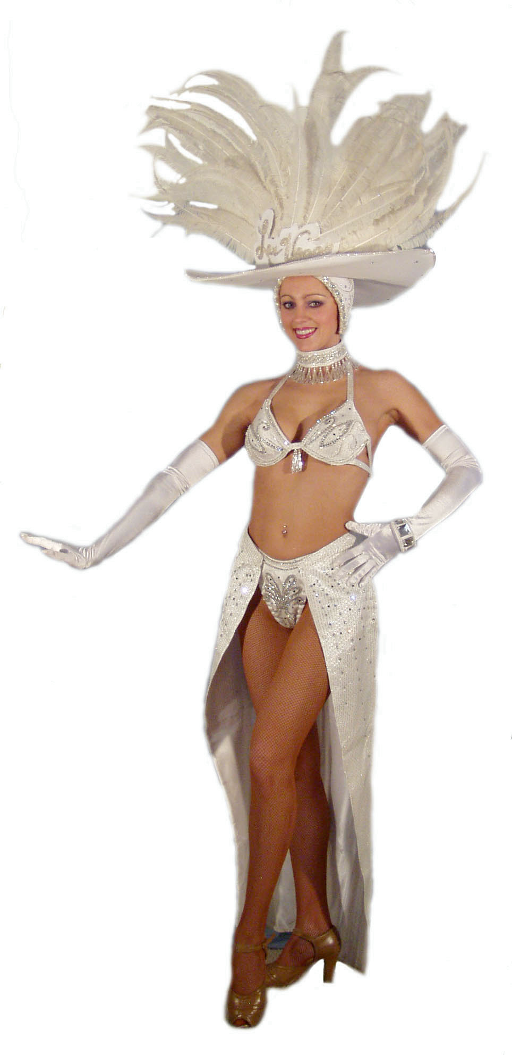
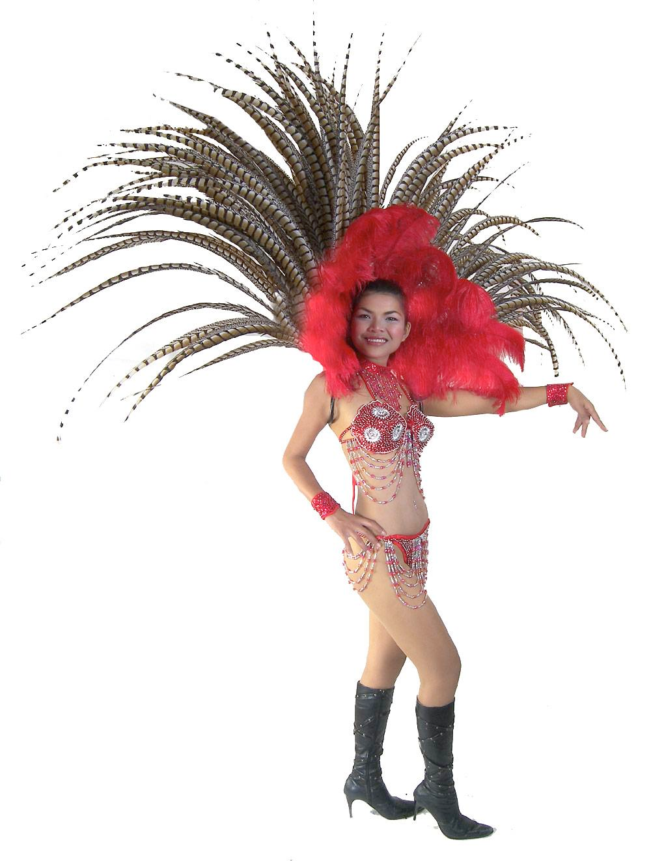
A relaxed rhumba. Showgirls blissfully jiggle.

Slide 7
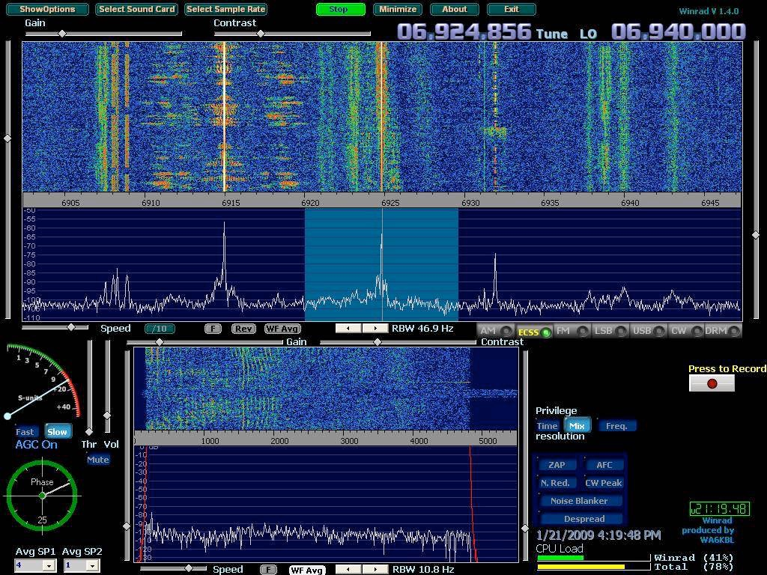
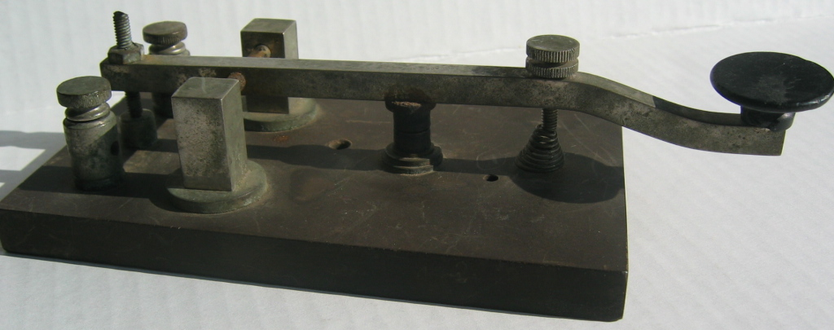
Morse code signals the confirmation of approaching doom.

Slide 8
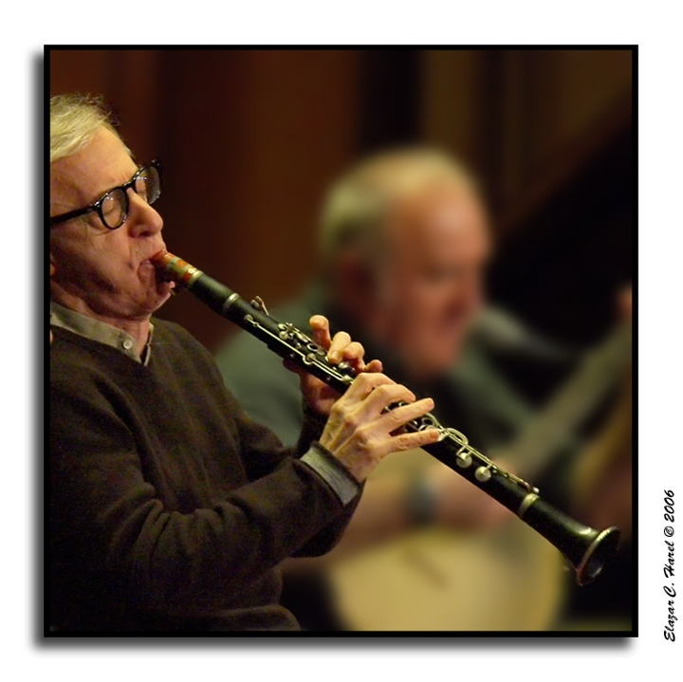
The players finish off their third set and head for the bar.

Slide 9
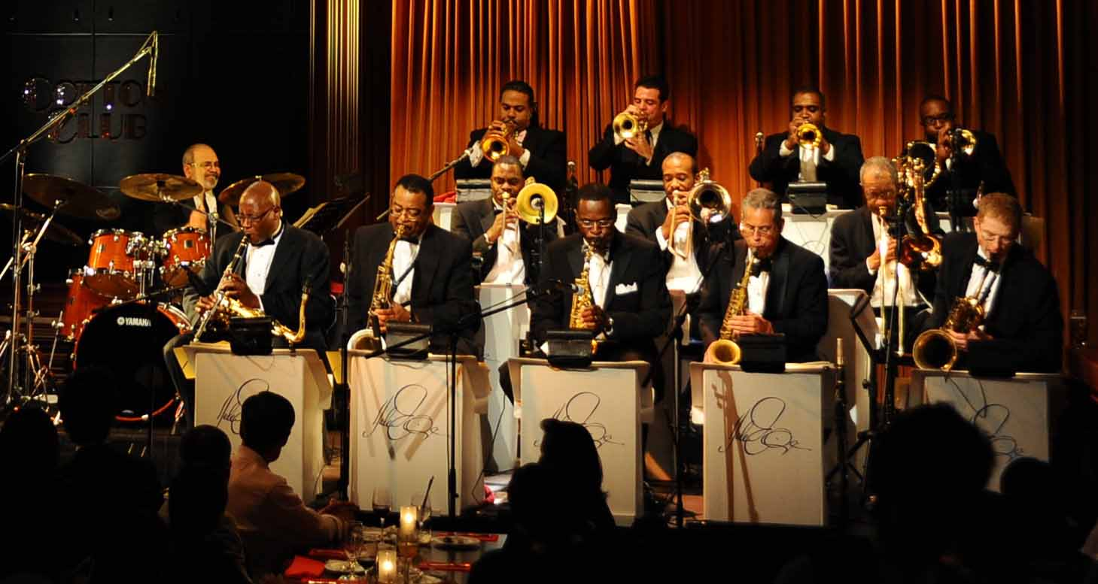
The players finish off their third set and head for the bar.

Slide 10
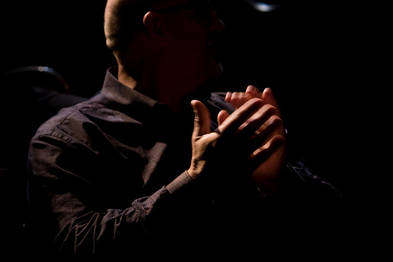
As applause fades,
outside we hear :

Slide 11
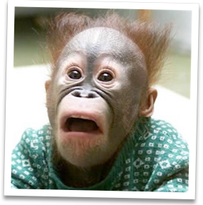
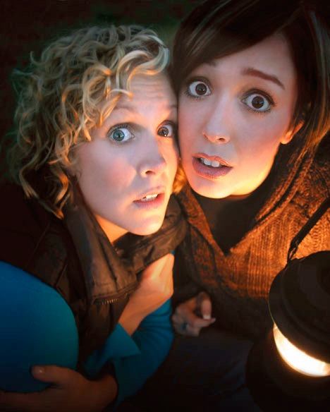
Oh no, oh no, oh no!

Slide 12
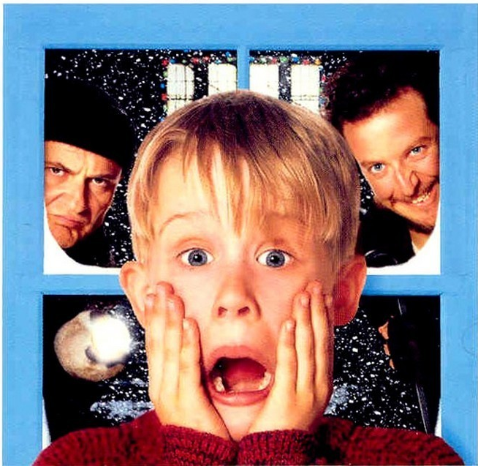
Oh no, oh no, oh no!
… it’s:

Slide 13
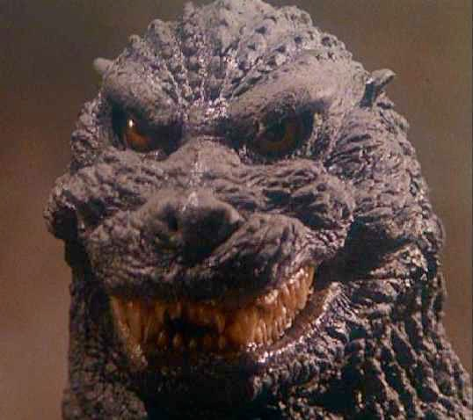
Godzilla!
Glorious Godzilla!!

Slide 14
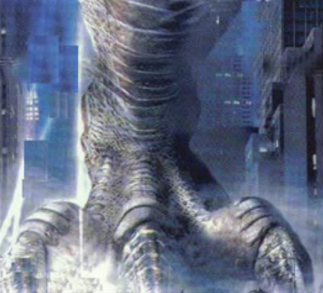
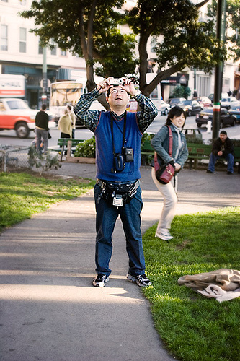
Godzilla destroys cars, screaming tourists, etc.

Slide 15
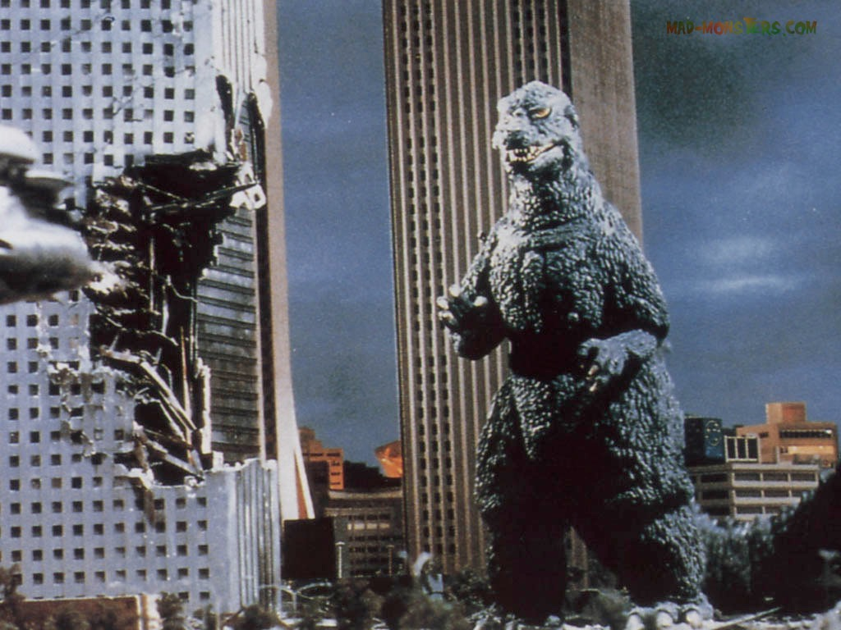
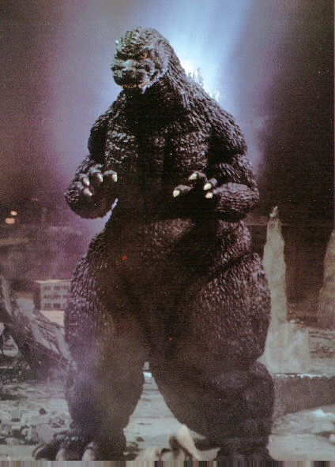
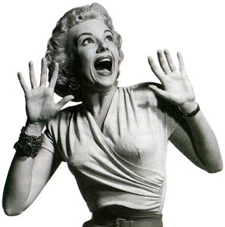
Godzilla destroys cars, screaming tourists, etc.

Slide 16
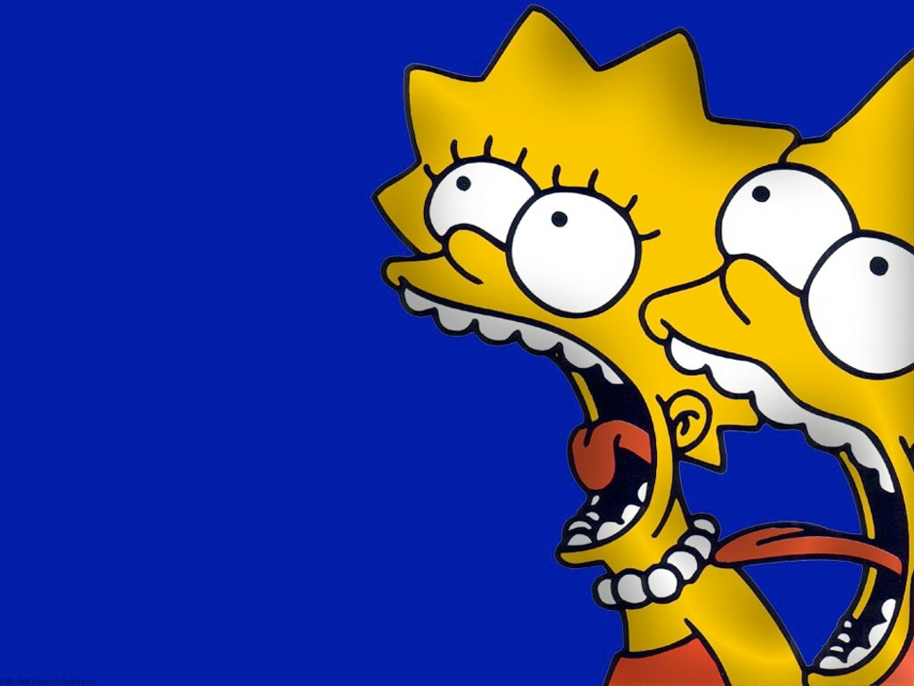

Slide 17
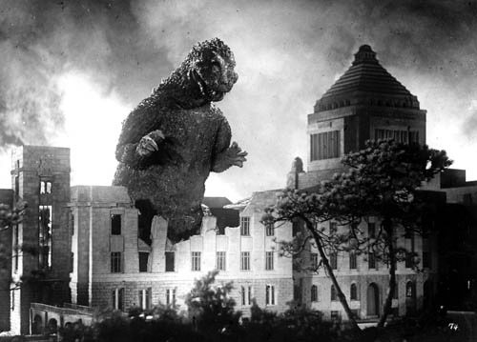

Slide 18
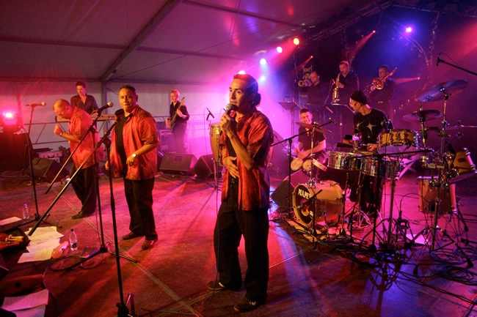
The band, quasi Greek Chorus, calls for Godzilla to Mambo.

Slide 19
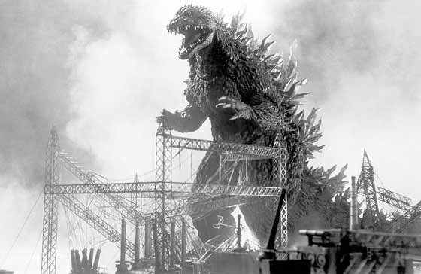
Godzilla!

Slide 20
The band, quasi Greek Chorus, calls for Godzilla to Mambo.

Slide 21
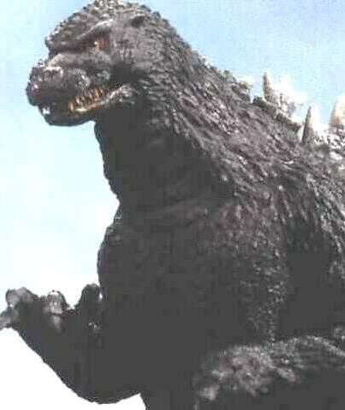
Godzilla!

Slide 22
The band, quasi Greek Chorus, calls for Godzilla to Mambo.

Slide 23
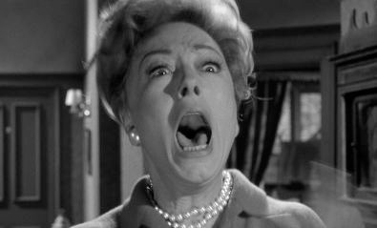

Slide 24
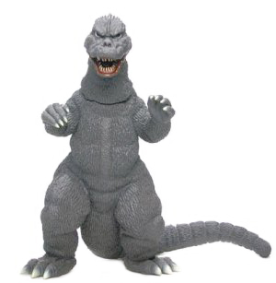
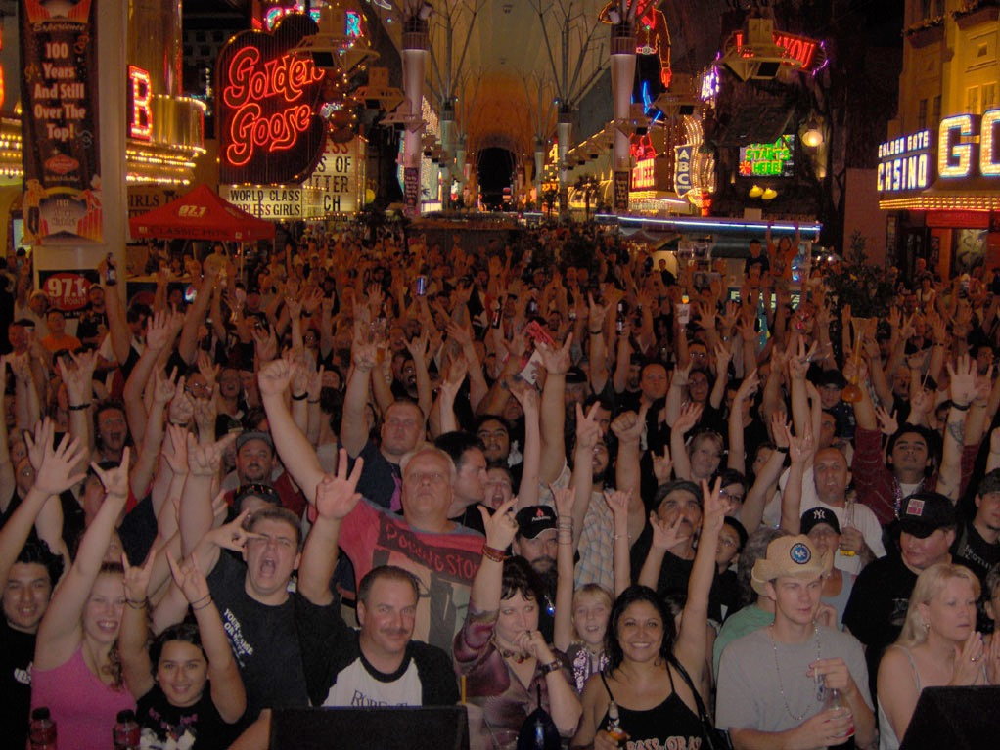
Godzilla mambos, casually crushing hysterical Vegans without missing a step.

Slide 25
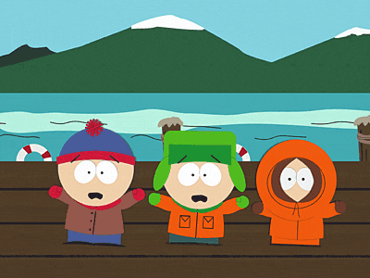
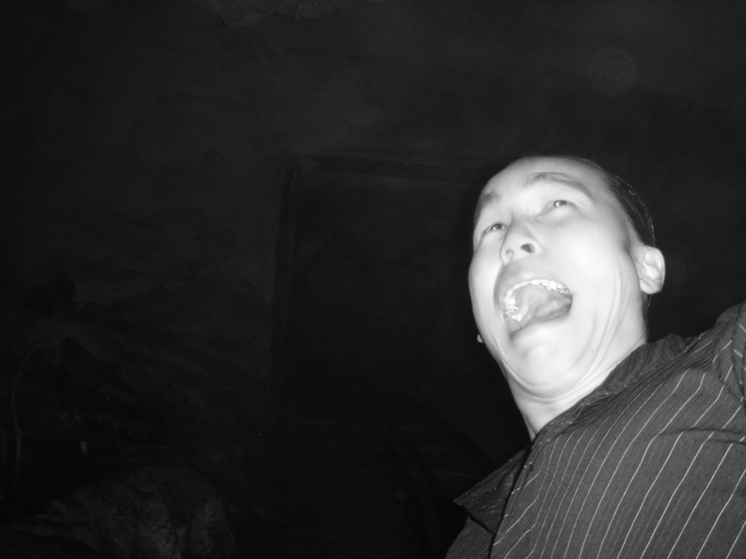
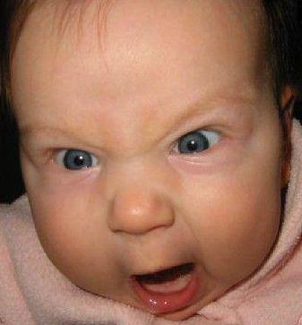

Slide 26
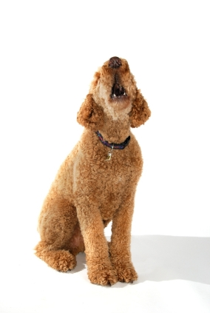
A tiny terrier barking bravely, then:

Slide 27
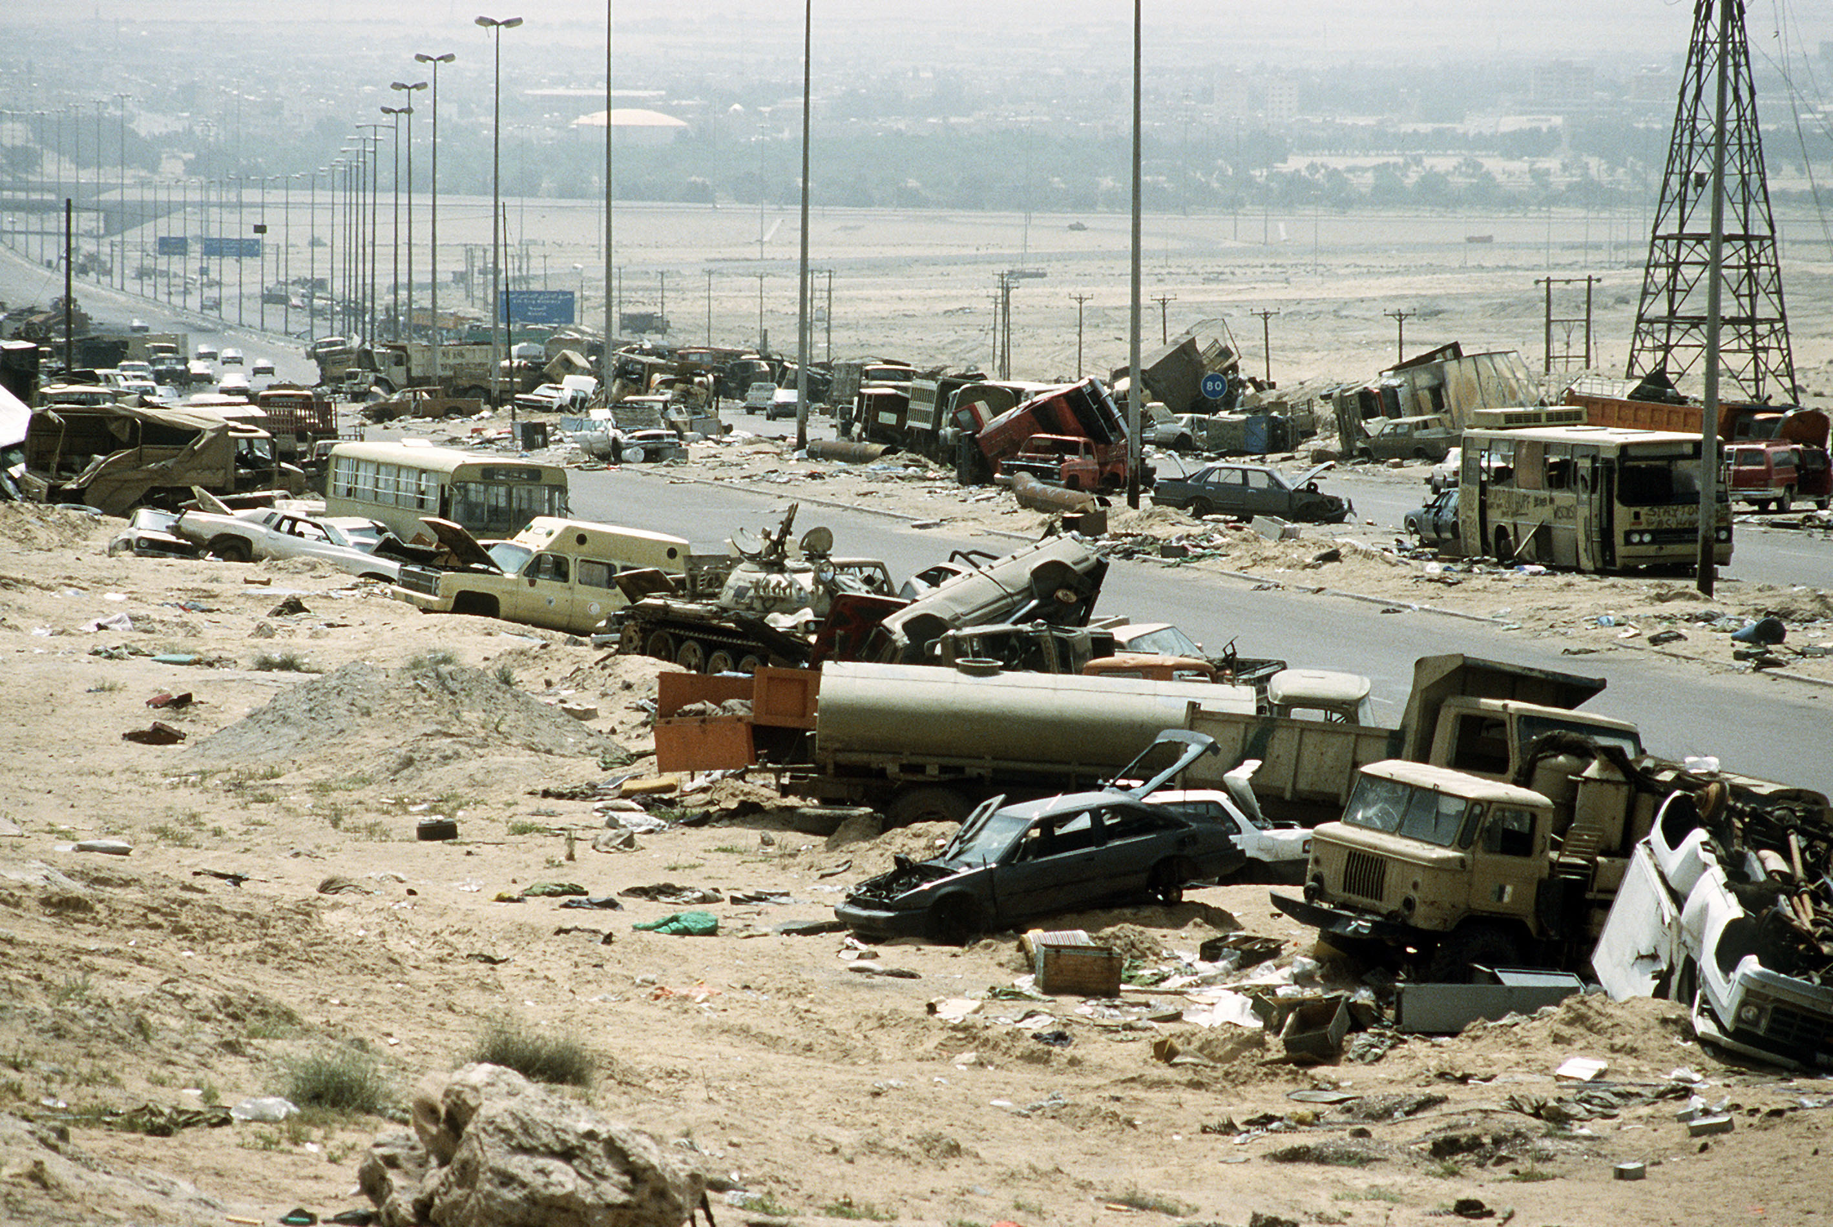
Demolishing everything in his path… not even the doggie escapes!

Slide 28
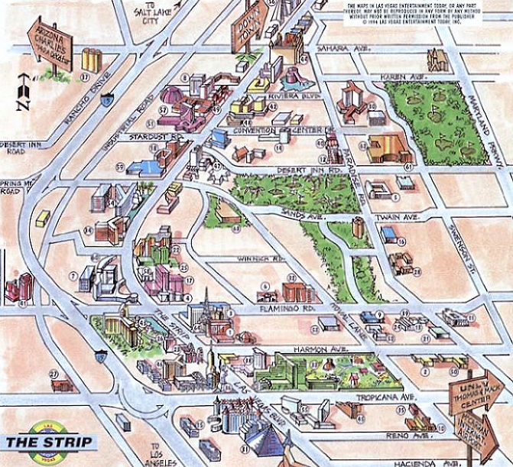
As Godzilla heads down the strip, searching relentlessly for:

Slide 29
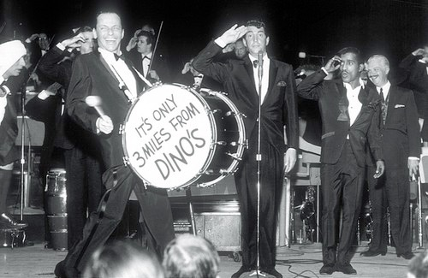
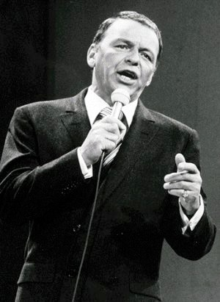
Frank Sinatra

Slide 30
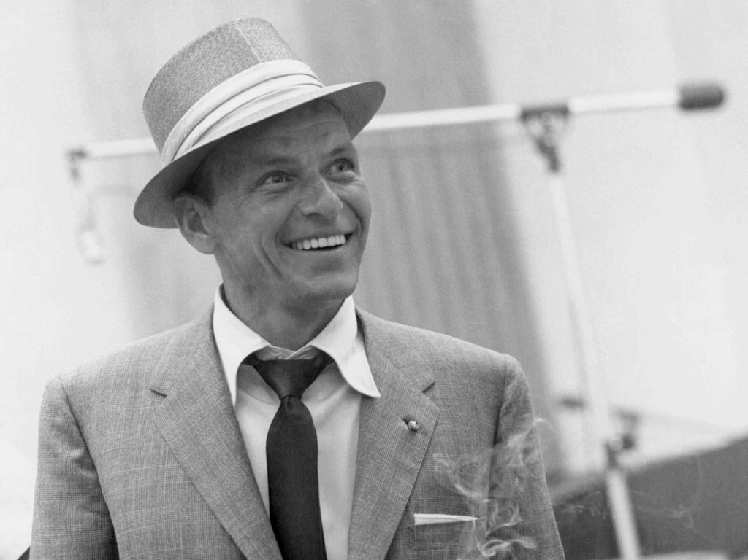
Frank Sinatra
Stomped!

Slide 31
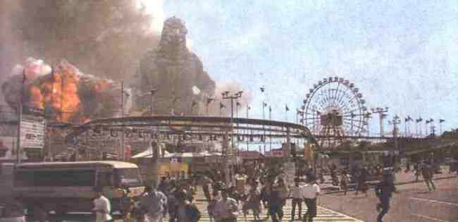

Slide 32
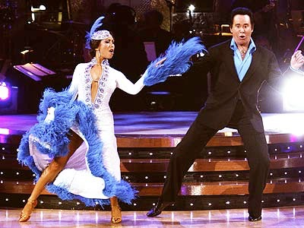
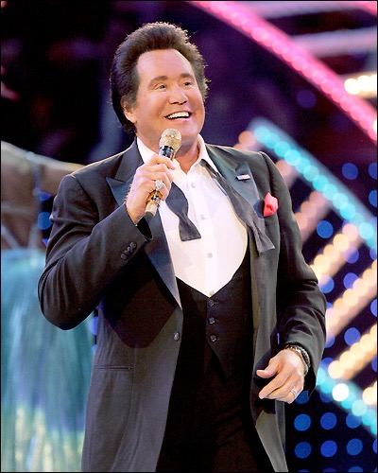
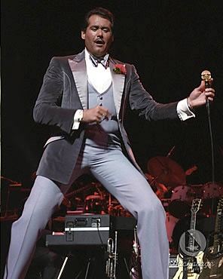
Wayne Newton

Slide 33
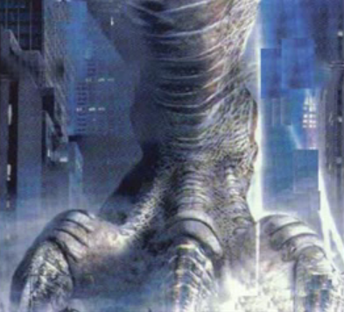
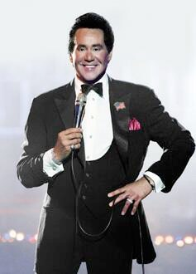
Wayne Newton
Stamped!

Slide 34
Liberace

Slide 35
Liberace
Stepped Upon!

Slide 36
The Village Gods destroyed,
Godzilla continues his carnage until The City of Sin is leveled!

Slide 37
The Village Gods destroyed,
Godzilla continues his carnage until
The City of Sin is leveled!

Slide 41
A fearless army of Elvises (Elvi) appear in the distance, formation marching through the littered streets.

Slide 42
A fearless army of Elvises (Elvi) appear in the distance, formation marching through the littered streets.

Slide 43
The Elvi attack, using bombers, missiles, etc.

Slide 44
The Elvi attack, using bombers, missiles, etc.

Slide 45
ROAR!

Slide 46
and the Elvi scatter like mice!

Slide 47
Wicked laughs from Godzilla follow...

Slide 48
The Sphinx sits outside The Luxor, looking seductive in a Mae West sort of way.

Slide 49
Godzilla takes one look and his eyes pop out of his head.

Slide 50
The Sphinx (Sphinxtress?) seduces the Reptile who instantly falls in love and begins to:

Slide 51
Tango with her.

Slide 52
As they dance, the Elvi slowly regroup and head for the:

Slide 53
Pirate ships at Treasure Island.

Slide 55
The Elvi approach the dancing monster and launch a ferocious volley of cannonballs directly at him.

Slide 58
The cannonballs find their mark, and Godzilla:

Slide 59
Falls to the ground
… annihilated.
The Elvi are triumphant!

Slide 60
The lounge is open again, and the city of Las Vegas toasts the victory. The scene climaxes with:

Slide 61
People happy, tearful, etc. Stock footage. Stock music.

Slide 62
People happy, tearful, etc. Stock footage. Stock music.

Slide 63
People happy, tearful, etc. Stock footage. Stock music.

Slide 64
A dark, ominous, and VERY familiar sound…

Slide 66
Godzilla lives! Godzilla lives!
(possible sequel?)

Slide 67
The Show is over. The End.

